Slide 1
GDIT Tech Talk
The Promise of Deep Learning across Federal Missions

Slide 2
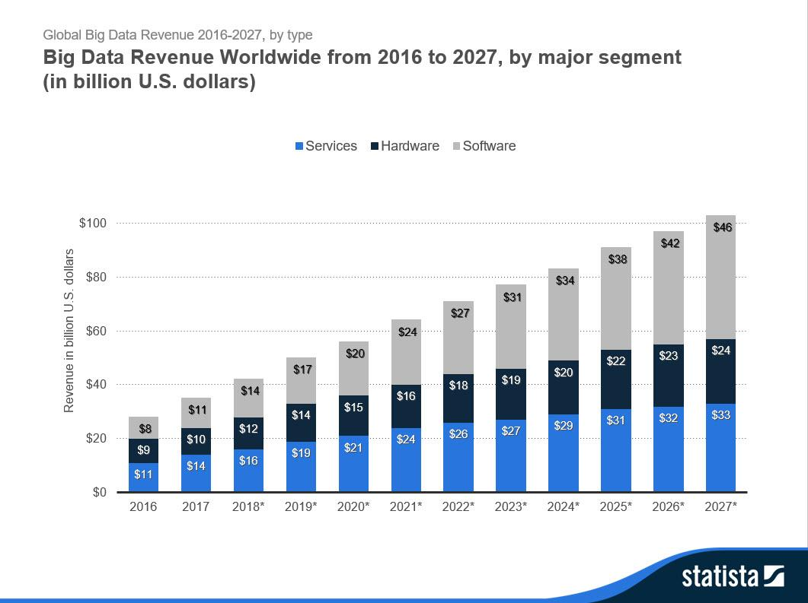
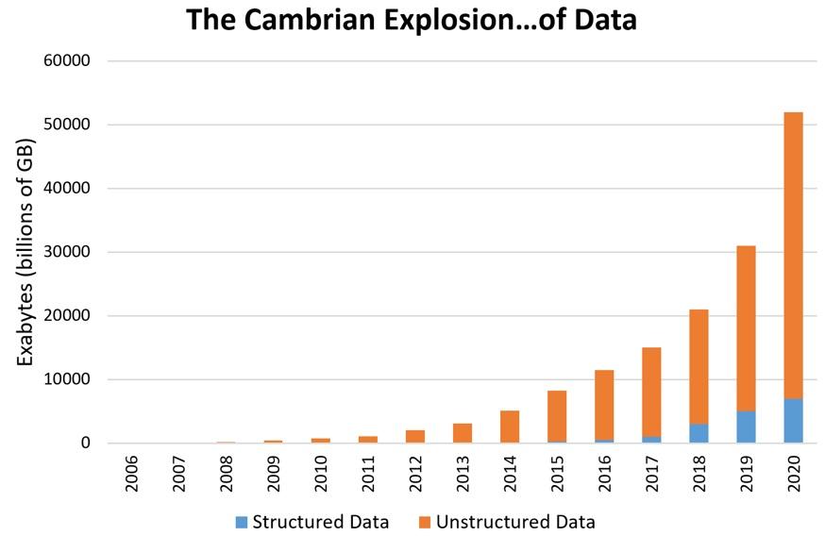
Big Data keeps getting bigger
Organizations seek to continually improve operational efficiency through analytic insights from the data, creating the imperative for more data analytic skills
Notes:
https://www.forbes.com/sites/louiscolumbus/2018/05/23/10-charts-that-will-change-your-perspective-of-big-datas-growth/#3d0f2e9d2926

Slide 3
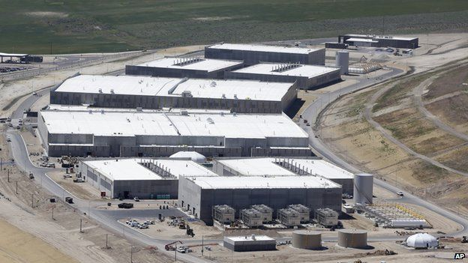
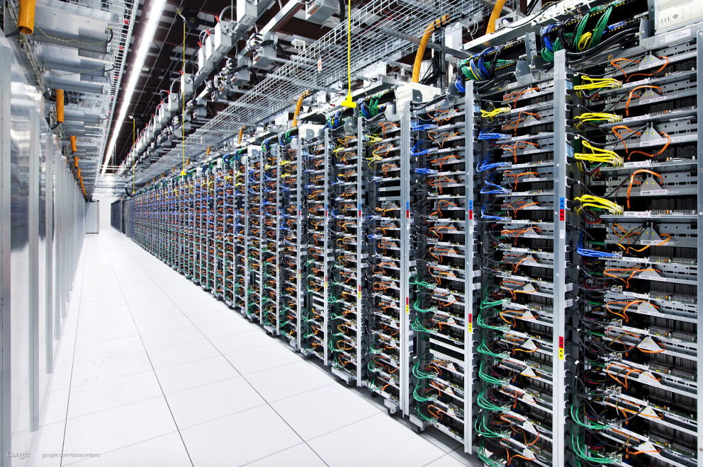
Big Data keeps getting bigger – where is it stored ?
Data Centers
“The Cloud”
NSA Data Center, Bluffdale Utah
Capacity: 1000 Trillion Gigabytes - 1 Yottabyte
Google, Amazon, Microsoft and Facebook. Estimates are that the big four store at least 1,200 petabytes
Notes:
https://www.sciencefocus.com/future-technology/how-much-data-is-on-the-internet/

Slide 4
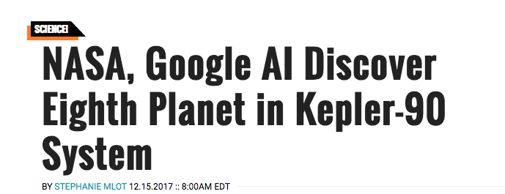
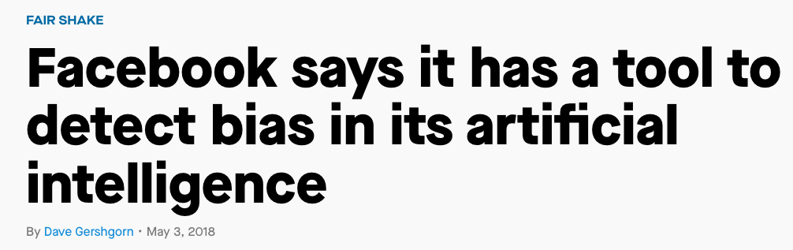
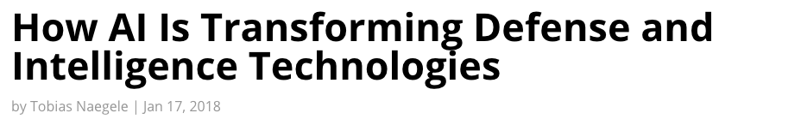
Artificial Intelligence is all around us
Image Recognition
Face and Emotion Recognition
Robotic Cars
Speech Understanding
Speech Synthesis
Language Translation
Conversational Bots
Predictive Analytics

Slide 5
Why is AI so pervasive today?
Big Data
Open Source Machine Learning Algorithms
Deep Learning - TensorFlow
Improved Computation
GPUs are faster and cheaper than CPUs
Affordable
Elastic Cloud Resources
Low barrier to entry
“It is a renaissance, it is a golden age … We are now solving problems with machine learning and artificial intelligence that were … in the realm of science fiction for the last several decades. And natural language understanding, machine vision problems, it really is an amazing renaissance.”
AWS CEO, Jeff Bezos May 2017

Slide 6

What is Deep Learning?
Sourced from NVIDIA blog
Reduces need for feature engineering
Generalize more readily and tolerate noisy data
Higher accuracy
The Deep Learning Subset of Artificial Intelligence and Machine Learning Employs Neural Nets with Multiple Hidden Layers to Improve Machine Learning Accuracy, Now Beyond Human Capabilities

Slide 7

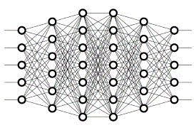
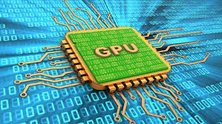
The Perfect Storm for Deep Learning
Explosion
of data
Rapid Progress
of research and open source applications of neural networks
Artificial Intelligence now is spreading outside of research into everyday activities and operations
GPUs and Cloud
Overcome computational constraints

Slide 8






Self-Service tools increase Data Analytics productivity
Self-Service
Data Preparation
Self-Service
Machine Learning
Self-Service
Data Visualization
Acquire
Store
Transform
Analyze
Consume
Retrospective
Predictive
Data Science
AI/ML
Models
Predictions
Visualizations
Analytics
APIs
Enterprise Data
Reference Data
External Data
Data Lakes
Data Warehouses
Object Stores
Files / HDFS
Clean
Enrich
Integrate
Cloud-native platforms support entire Data Analytics Pipeline

Slide 9
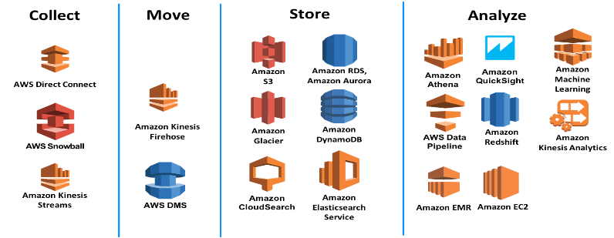

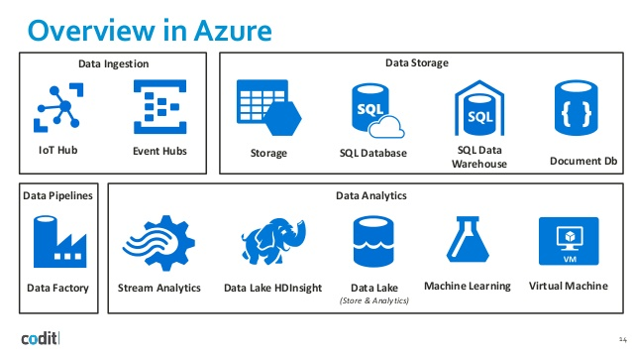

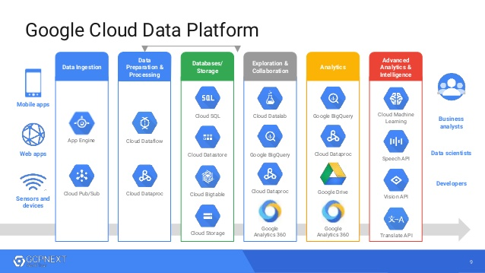


Cloud Services provide rich AI/ML and Data Analytics services
Agile Innovation
Increased Capability
Reduced Time to Delivery
Elastic Scalability
Lower Administration Cost

Slide 10
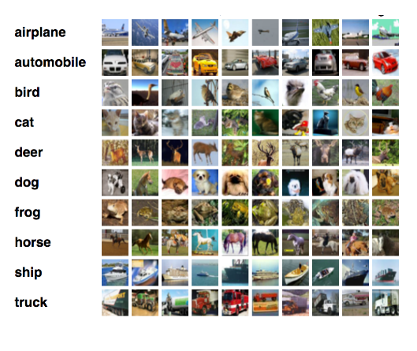
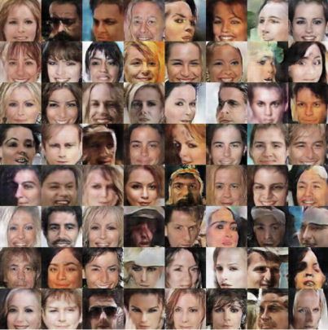
Open Source underpins this revolution
Deep Learning Break-Throughs
Image classification
Text Generation
Language Translation
Generative Adversarial Networks
Open Source Projects
Apache Hadoop
Apache Spark
Deep Learning Neural Networks
ImageNet on GPUs
Programming Packages
Python Data Science
R Data Science
Analyst Notebooks (Jupyter)

Slide 11
Key skills needed

Slide 12
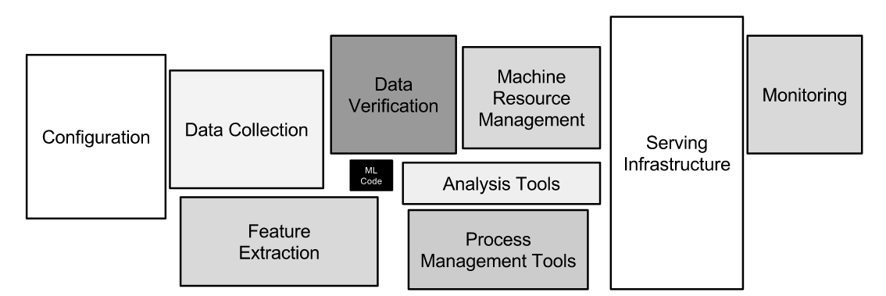
Data Science is just a part of a complex whole
“Only a small fraction of real-world ML systems is composed of the ML code, as shown by the small black box in the middle. The required surrounding infrastructure is vast and complex.”
Hidden Technical Debt in Machine Learning Systems (Sculley, et al)
https://papers.nips.cc/paper/5656-hidden-technical-debt-in-machine-learning-systems.pdf

Slide 13
Data Scientist Key Abilities
Data Scientist
Data Integration
Programing
(R, Python)
Data Visualization
Big Data Skills
Communication Skills
Analytics-
AI/ML, Statistics

Slide 14
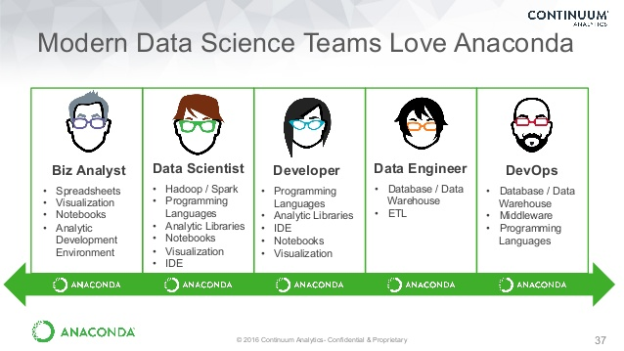
Data Science Team Roles and Skills

Slide 15
Key Skills – Technical & Soft
Analytics
Data Profiling & Discovery
AI/Machine Learning
Graphics skills (plots, layout)
Data Visualization
Soft Skills
Curiosity and fearlessness
Data scavenger and hoarder
Open source orientation
Fail Fast
Story teller
Programming
Computer Programming (R, Python)
Statistics and Statistical Analysis
SQL Scripting
Distributed Processing Frameworks
Hadoop, Spark Ecosystem
Data Architecture
Data Modeling
Database Design
NoSQL, Columnar, In-Memory Databases
Data Wrangling
ETL and Data Integration
Streaming Ingestion and Analysis

